Slide 1
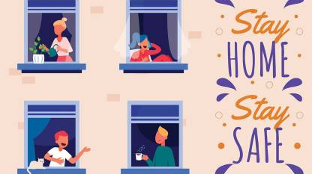
When staying home is a safety risk:
Intersectional vulnerability of pandemic, gender-based violence and migration.

Slide 2
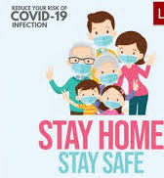
'saving lives'
some lives are considered expendable, and some are valued
“New normal’ has re-normalised the old power relations by excluding the marginalised from the pandemic measures.
'work from home' or 'stay home, stay safe,' exclude the expendable lives by assuming having a safe home as standard.

Slide 3
Studies regarding Covid-19 and GBV
increased economic dependence of victims, instability and stress, fewer opportunities to seek refuge, misunderstanding of physical and mental harm, lockdown with abusive partners, reduction of support for victims of GBV and IPV. (Veiro et al 2020)
Identifying the causes of increased GBV and IPV during the COVID-19 pandemic tends to normalise structural violence and its reproduction. If not connected to the gender structural power relations.

Slide 4
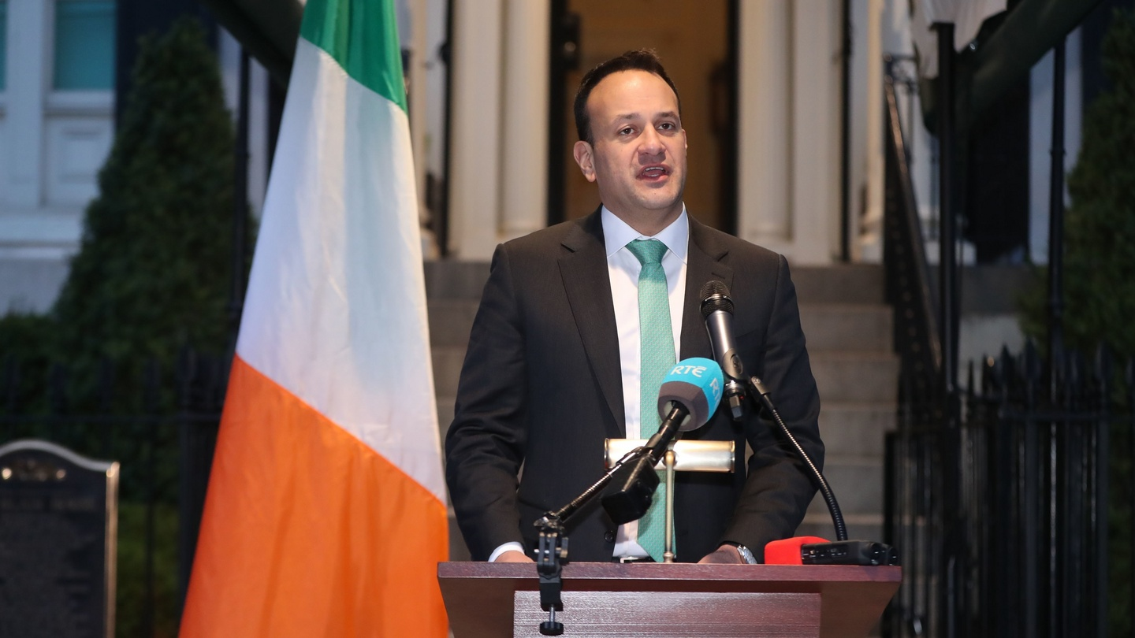
The then Taoiseach, Leo Varadkar
“We need to stop the spread of the virus and to shelter our most vulnerable and to protect them.”

Slide 5
Prioritizing some lives over others.
Prioritisation of ‘productive work’ over ‘care work’ and/or ‘reproductive work’ derived from the interrelation between capitalism and patriarchy, a coalition that makes profits from women's unpaid care and reproductive work by maintaining the division of labour between genders
Ireland’s neoliberal policy that is bent to privatise and leave to market forces critical components of the care sector that deal with the least powerful members of society

Slide 7
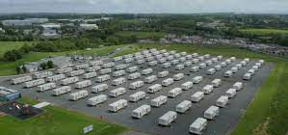
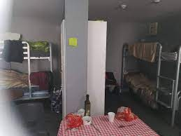
Direct provision
No data transparency
No records about the causes of death.
Mismanagement.

Slide 8
Still Here Campaign
An awareness campaign to let everyone know that the services are ‘still here’ like before.
Calls to the ‘Women’s Aid’ national helpline for support increased by 36%, visiting their website increased by 74% and
Police calls to report domestic violence increased by 25%.
Still Here’ has not been translated into other languages, and there are currently no plans to do so.

Slide 9
Structural violence
The state not doing what could have been done at the institutional level to support the resilience and agency of women at risk of GBV under difficult circumstances, and to otherwise prevent the exacerbation of GBV at the interpersonal level, despite knowing the consequences, is a form of GBV that is enabled by the state’s inaction.

Slide 10
Pandemic slogans and alienation
This discursive exclusion and insensibility work hand in hand with structural exclusion and create a sense of alienation, non-belonging and helplessness to the women suffering from GBV or at risk of it.
For the women who do not have safety in their own house or for the ones who do not even have a home, ‘stay home’ slogans are a form of exclusion that hurts.

Slide 11
Migrant women who are at most risks of GBV due to the multi-layered conditions of precarity, are not the ones whom the state is concerned about at al
Thank you .

